Slide 1



Design for testability as a way to good coding
Simone Chiaretta Architect, Council of the EU
http://codeclimber.net.nz
Twitter: @simonech
December 9th, 2010

Slide 2
Who the hell am I?
Simone Chiaretta
Microsoft MVP ASP.NET
ASP Insider
Blogger – http://codeclimber.net.nz
Italian ALT.NET UG Founder
OpenSource developer
Climber
All Around Nice Guy
Disclaimer:"The views expressed are purely those of the speaker and may not in any circumstances be regarded as stating an official position of the Council"

Slide 3
What are we going to talk about?
What is “Good Design”?
Testability requirements?
What is Design for Testability?
What is Dependency Injection?
What is Inversion of Control?
How to do IoC via DI using Ninject?
How to do IoC via DI using Unity?
References

Slide 4
What is Good Design?

Slide 5
What is Good Design
High Cohesion
Low Coupling
Good Encapsulation
Notes:
Cohesion:
“A measure of how strongly-related and focused the various responsibilities of a software module are” - Wikipedia
Coupling:
“The degree to which each program module relies on each one of the other modules” – Wikipedia
Encapsulation:
“The hiding of design decisions in a computer program that are most likely to change” - Wikipedia

Slide 6
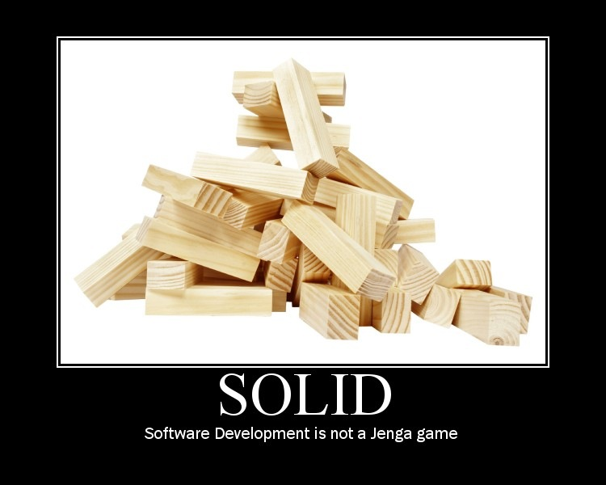
What is Good Design
Notes:
Jenga game = tower where if you remove one piece, all the tower can collapse

Slide 7
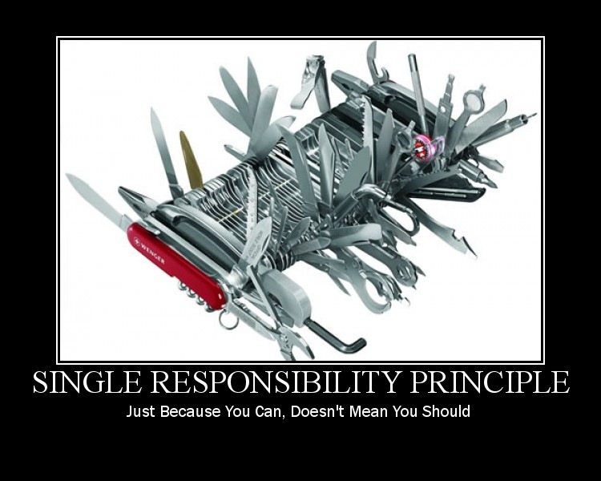
Solid: Single Responsibility Principle (SRP)
A class should have one, and only one, reason to change.

Slide 8
Solid: Single Responsibility Principle (SRP)
“If a class has more then one responsibility, then the responsibilities become coupled. Changes to one responsibility may impair or inhibit the class’ ability to meet the others. This kind of coupling leads to fragile designs that break in unexpected ways when changed.”
Robert C. Martin

Slide 9
Solid: Single Responsibility Principle (SRP)
Email Sending App
Email Sending App
Email Sender
File
Flat File
XML File
Notes:
Example might be an email sending application that sends email taking the text from an external file:
If you read the text and send the email from the same class you are breaking the SRP principle.
It would be better to separate the reading part from the sending one.

Slide 10
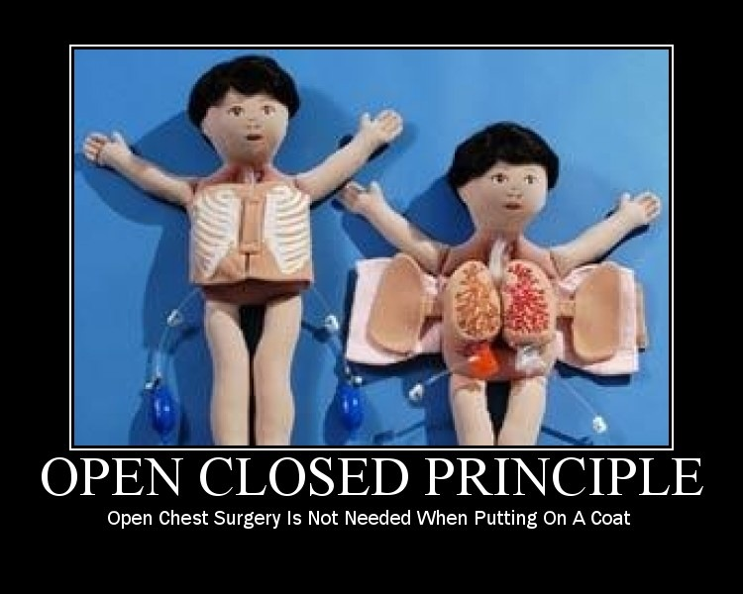
sOlid: Open Closed Principle (OCP)
You should be able to extend a classes behavior, without modifying it.

Slide 11
sOlid: Open Closed Principle (OCP)
“Modules that conform to the open-closed principle have two primary attributes.
They are “Open For Extension”. This means that the behavior of the module can be extended. That we can make the module behave in new and different ways as the requirements of the application change, or to meet the needs of new applications.
They are “Closed for Modification”. The source code of such a module is inviolate. No one is allowed to make source code changes to it.”
- Robert C. Martin

Slide 12
sOlid: Open Closed Principle (OCP)
FileReader
Service
Email Sender
IFileFormat Reader
Flat File
XML File

Slide 13
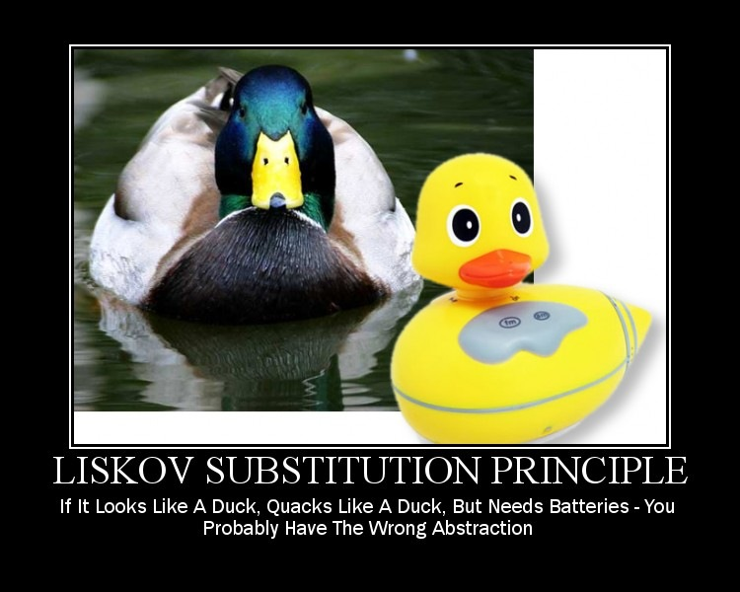
soLid: Liskov Substitution Principle (LSP)
Derived classes must be substitutable for their base classes.

Slide 14
soLid: Liskov Substitution Principle (LSP)
“If for each object o1 of type S there is an object o2 of type T such that for all programs P defined in terms of T, the behavior of P is unchanged when o1 is substituted for o2 then S is a subtype of T.”
- Barbara Liskov
Notes:
It’s all about behaviours and pre/post conditions:
A derived type can only weaken pre-conditions
A derived type can only streghten post-conditions

Slide 15
soLid: Liskov Substitution Principle (LSP)
Database
FileReader
Service
Email Sender
IFileFormat Reader
Flat File
XML File
Database Connection File
Notes:
Imagine you want to put templates in a database: you cannot just write a “file” reader that uses a database as it will need a connection string, and the user should do different things based on the type of the reader, thus making the substitution not transparent.

Slide 16
soLid: Liskov Substitution Principle (LSP)
Database
Database
Reader
Service
Flat File
Email Sender
IFileFormat Reader
FileReader
Service
XML File
Notes:
Here it would have been better to completely separate the two things, and have a database reader and a file reader.

Slide 17
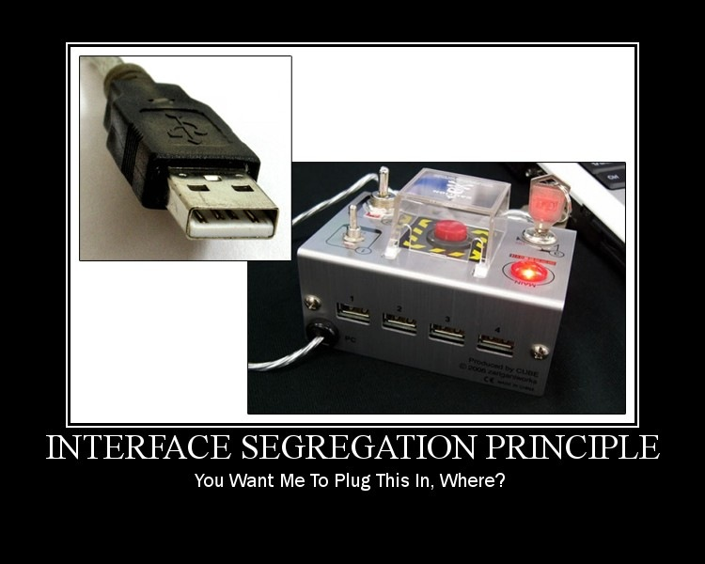
solId: Interface Segregation Principle (ISP)
Clients should not be forced to depend upon interfaces they don’t use

Slide 18
solId: Interface Segregation Principle (ISP)
“This principle deals with the disadvantages of ‘fat’ interfaces. Classes that have ‘fat’ interfaces are classes whose interfaces are not cohesive. In other words, the interfaces of the class can be broken up into groups of member functions. Each group serves a different set of clients. Thus some clients use one group of member functions, and other clients use the other groups.”
- Robert Martin
Notes:
After adding the Database reader, we now have the email sending service that can both read file and databases, and obviously sending emails.
So it’s better to split these responsibilities in different interfaces.

Slide 19
solId: Interface Segregation Principle (ISP)
EmailSender
EmailSender
Database Reader
Service
SendEmail
ReadFile
ReadFromDb
SendEmail
GetMessageBody
FileReader
Service
GetMessageBody

Slide 20
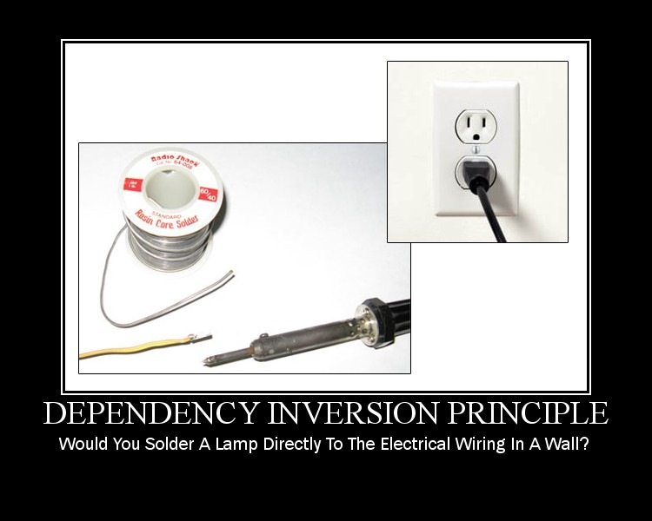
soliD: Dependency Inversion Principle (DIP)
Depend on abstractions, not on concretions.

Slide 21
soliD: Dependency Inversion Principle (DIP)
“What is it that makes a design rigid, fragile and immobile? It is the interdependence of the modules within that design. A design is rigid if it cannot be easily changed. Such rigidity is due to the fact that a single change to heavily interdependent software begins a cascade of changes in dependent modules.”
- Robert Martin

Slide 22
soliD: Dependency Inversion Principle (DIP)
Xml File Reader
Flat File Reader
IFileFormat Reader
Database Reader Service
File Reader Service
Email Sender
IMessageInfoRetriever
IEmailService
ProcessingService
Notes:
Finally, instead of having the single object create their own dependencies, it is the top-most client that configures the system for what it needs.

Slide 23
Before and After
IMessageInfo
Retriever
IEmailSender
EmailProcessingService
Email Sending App
Flat File
Database
Database
Reader
Service
IMessage
Info
Retriever
File
XML File
IFileFormat Reader
FileReader
Service
EmailService
IEmail
Service
Before
After

Slide 24

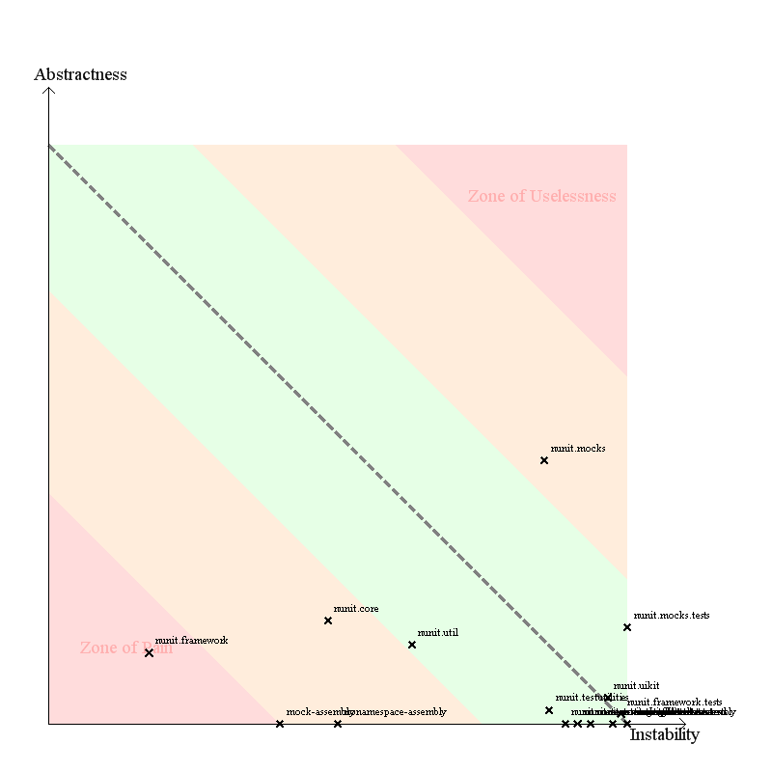
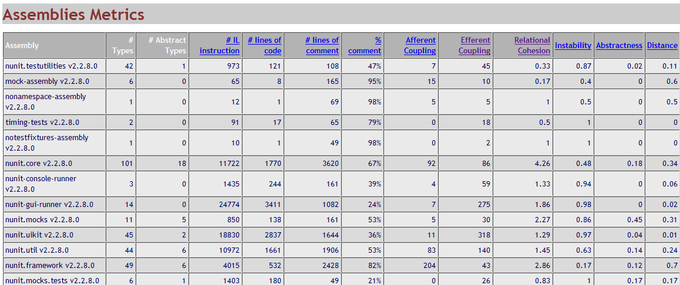
How to test for “good design”?
You can’t
Actually you can ☺
Clear?

Slide 25
Testability Requirements

Slide 26
Testability Actors
System Under Test
Depended On Component
Mock/Fake/Stub

Slide 27
Testability Concepts
Test just one feature
Indipendency from environment
Indipendency from dependencies
Fast

Slide 28
Design for Testability

Slide 29
Design for Testability = Good Design
Good design is difficult to measure
Easily testable = Good Design

Slide 30
What is Dependency Injection

Slide 31
Bad Code
Demo:
Hard-Coded Dependencies
1-2

Slide 32
The problem of strong coupling
Rigid – Must change the Climber code to change the Tools he uses
Fragile – Changes to the Tools can affect the Climbers
Not Testable – Cannot replace the Tools with a stub/fake when I want to test the Climber in isolation

Slide 33
Better Code
Demo:
Hard-Coded Dependencies
with Interface
3

Slide 34
Still problems
We have lower coupling but still Climber has to be changed to change tools

Slide 35
Slightly Better Code
Demo:
Hard-Coded Dependencies
with Service Locator
4

Slide 36
Still problems
Still Climber depends on the Locator
Just moving the problem inside another module

Slide 37
Introducing Dependency Injection
Demo:
Dependency Injection
by Hand
5

Slide 38
Good, isn’t it?
Climber is always the same, and doesn’t know how to “get” the tools
The Climber is given the tools he has to use

Slide 39
Dependency Injection
Are we done?
NOT YET!

Slide 40
Introducing Dependency Injection
Demo:
Dependency Injection
by Hand
(more complex)
6

Slide 41
Needs Improvements
Host must know how to assemble dependencies
We loose encapsulation

Slide 42
What is Inversion of Control

Slide 43
Inversion of Control
Demo:
Inversion of Control
7

Slide 44
What we achieved
Still have DIP
Got encapsulation back
Dependencies are handled by external component

Slide 45
How to configure
XML
Attributes
Fluent API
all of them

Slide 46






Many IoCC
…

Slide 47
Ninject

Slide 48
The Kernel
Factory Method on Steroids
Hold the configuration
Returns objects
IKernel kernel = new StandardKernel(
new ClimbingModule());
var climber = kernel.Get<Climber>();

Slide 49
Modules
Modules hold specific configurations
Configuration through Fluent API
Bind<Climber>().ToSelf();
Bind<IClimbingTools>().To<QuickDraws>();

Slide 50
Inversion of Control
Demo:
Inversion of Control
(complex)
8

Slide 51
Different kinds of Injection
Constructor Injection
Property Injection
Method Injection
Through Factory Method

Slide 52
Attributes
Are used to help discriminate injection patterns
[Inject]
public IClimbingTools tools {get; set;}
[Inject]
public void GetReady(IClimbingTools tools)

Slide 53
Inversion of Control
Demo:
Attributes
Injection Patterns
9

Slide 54
Behaviours
Singleton (Default)
Transient
Per Thread
Per Request
BYO
Bind<Climber>().ToSelf().InTransientScope();
Bind<Climber>().ToSelf().InSingletonScope();

Slide 55
Inversion of Control
Demo:
Activation Behaviours
10

Slide 56
But there is more...
Constructor Parameters
Contextual Binding
Named Binding
Bind<IClimbingTools>().To<IceScrews>() .WithConstructorArgument("brand",
"Black Diamond");
Bind<IClimbingTools>().To<QuickDraws>()
.WhenInjectedInto(typeof(SportClimber));
Bind<Climber>().To<SportClimber>()
.Named("Simone");
climber = kernel.Get<Climber>("Simone");

Slide 57
Inversion of Control
Demo:
Advanced Features
11

Slide 58
Finally Some Testing
No need to use IoC any more (and you should not)
MockTools tools = new MockTools();
Climber climber = new Climber(tools);
climber.Climb();
Assert.IsTrue(tools.Placed);

Slide 59
Finally some Testing
Demo:
Testing
12

Slide 60
P&P Unity

Slide 61
Unity
Microsoft IoC container
Configured via code
Configured through XML
myContainer
.RegisterType<IClimbingTools, QuickDraws>();
<unity>
<typeAliases>
<typeAlias alias="IClimbingTools” type="ClimbDemoIoCUnity.IClimbingTools, ClimbDemoIoCUnity" />
<typeAlias alias="QuickDraws” type="ClimbDemoIoCUnity.Tools.QuickDraws, ClimbDemoIoCUnity" />
</typeAliases>
<containers>
<container>
<types>
<type type="IClimbingTools" mapTo="IceScrews" />
</types>
</container>
</containers>
</unity>

Slide 62
Unity
Demo:
Unity
13

Slide 63
Bonus section: Func

Slide 64
Func
By Daniel Cazzulino (of Moq fame)
The fastest IoC available
Doesn’t use reflection
Always write factory method
container.Register<IClimbingTools>(
c => new QuickDraws());
container.Register(
c => new Climber(
c.Resolve<IClimbingTools>()));

Slide 65
Bonus section: Func
Demo:
Func
14

Slide 66
IoC inside other hosts

Slide 67
IoC in other hosts
IoC shines when activation is already delegated to factories
ASP.NET MVC
WCF
Requires changes in the default “object factory”
ControllerFactory
ServiceHostFactory

Slide 68
IoC in other hosts
Demo:
ASP.NET MVC
15

Slide 69
Conclusions

Slide 70
Call for Actions
Think about a project you worked on
Think about any maintainabily/change issue you had:
Most likely they would have been solved with DI/IoC
Think how DI/IoC could have helped

Slide 71
Main takeaways
DI/IoC helps building service oriented applications
DI/IoC helps managing dependencies
DI/IoC helps bulding highly cohese, loose coupled code while maintaling encapsulation

Slide 72
References
Uncle Bob’s Principle Of Object Oriented Development: http://butunclebob.com/ArticleS.UncleBob.PrinciplesOfOod
OO Design Principles: http://www.oodesign.com/design-principles.html
Complete SOLID slides and demo (Derick Bailey): http://www.lostechies.com/media/p/5415.aspx
Ninject: http://ninject.org/ - v2 http://github.com/enkari/ninject/ - v2.2 beta
p&p Unity: http://unity.codeplex.com/ - v2 (part of EntLib5)
Funq: http://funq.codeplex.com/

Slide 73
Contacts – Simone Chiaretta
MSN: simone_ch@hotmail.com
Blog:
English: http://codeclimber.net.nz/
Italian: http://blogs.ugidotnet.org/piyo/
Twitter: @simonech

Slide 74
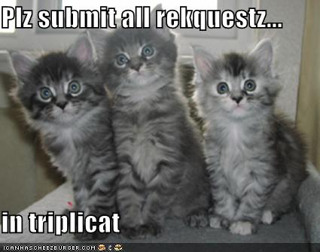
Questions?
Disclaimer:"The views expressed are purely those of the speaker and may not in any circumstances be regarded as stating an official position of the Council"

Slide 75
Rating
If you liked this talk, please consider rating it:
http://speakerrate.com/talks/5193-design-for-testability-as-a-way-to-good-coding
Disclaimer:"The views expressed are purely those of the speaker and may not in any circumstances be regarded as stating an official position of the Council"

